Slide 1


TargetWise Analytics: Customer Segmentation for Cooperatives
Leveraging KMeans and Random Forest for Targeted Marketing
April 08, 2025
by Samson Mutua

Slide 2





Why TargetWise Analytics?
Cooperative Challenge
Need to understand customer behavior
Traditional Methods
Manual, time-consuming, imprecise
Our Goal
Data-driven app for precise segmentation
Solution
Automated ML segmentation

Slide 3
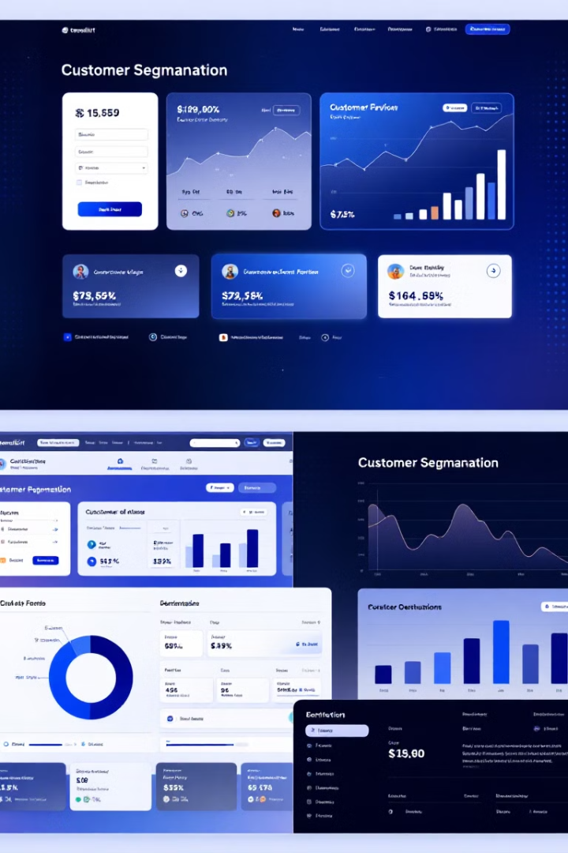
What is TargetWise Analytics?
Web App
Machine Learning
Built with Streamlit for cooperatives
KMeans clustering and Random Forest prediction
Features
Data upload, preprocessing, clustering, insights

Slide 4





How It Works: Technical Workflow
Upload Data
CSV/XLSX files
Preprocess
Handle missing values, standardize
Cluster
KMeans with Elbow Method
Predict
Random Forest model
Deploy
Real-time predictions

Slide 5
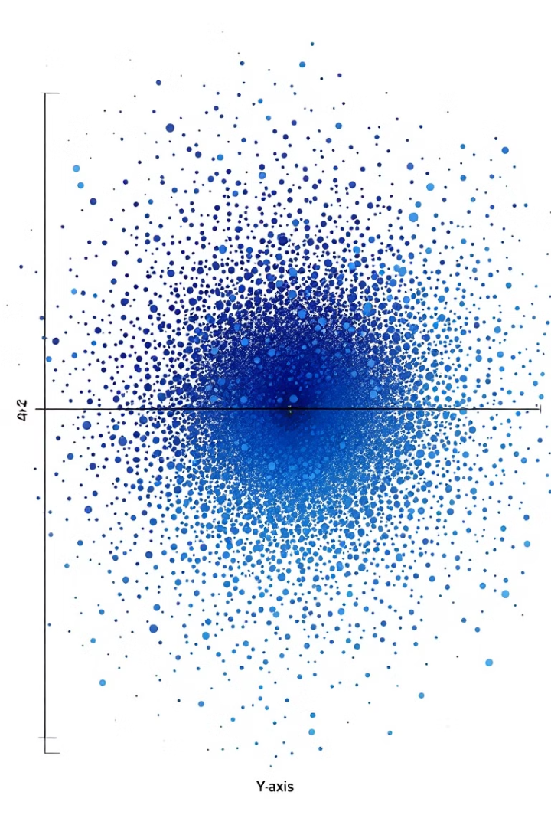




Key Features and Results
Interactive Data
Visualizations
Real-time
Elbow Method, PCA plots
85% prediction accuracy
Upload and preprocessing
Impact
4 distinct customer segments

Slide 6








Insights and Recommendations
Cluster 0
Cluster 1
Moderate overlap; focus on differentiation
Loyal customers; target with loyalty programs
Cluster 3
Cluster 2
High precision; ideal for targeted campaigns
Niche segment; offer specialized products

Slide 7




Impact and Benefits for Cooperatives
Time Savings
Automates segmentation process
Data-Driven Strategy
Enables informed marketing decisions
Customer Engagement
Increases conversion rates
Business Optimization
Better inventory and product recommendations

Slide 8





Conclusion and Future Work
Empowering Cooperatives
Actionable insights from segmentation
Advanced Models
Deep learning integration
Real-time Updates
Dynamic data processing
Industry Expansion
Beyond cooperatives

